Slide 1
Malignancy Detector
BY: Adesola Fakiyesi, Kimberly Kockenmeister, and Kendall Sisk

Slide 2
Table of Contents
The Facts About Breast Cancer
The Purpose and Objectives of this Project
The Data
Cleaning the Data
Machine Learning Models
Flask API
Deployment
Our App

Slide 3
The Facts About Breast Cancer
CDC (Center for Disease Control) :“Breast cancer is a disease in which cells in the breast grow out of control. There are different kinds of breast cancer. The kind of breast cancer depends on which cells in the breast turn into cancer.
Every 2 minutes, a woman is diagnosed with breast cancer in the US.
In the US, 1 in 8 women will be diagnosed with breast cancer in their lifetime.
Each year it is estimated that over 220,000 women in the United States will be diagnosed with breast cancer and more than 40,000 will die.
A man’s lifetime risk of breast cancer is about 1 in 1,000.
Women who get regularly screened for breast cancer have a 47% lower risk of dying from the disease compared to those who don’t.
Breast cancer deaths have been declining since 1990 thanks to early detection, better screening, increased awareness, and new treatment options.

Slide 4
The Purpose and Objective
The purpose of this project is to create an ‘Application Detector’ which would help in the early diagnosis of breast cancer.
The objective of this project is to classify whether the user’s tumor is benign or malignant.
Early detection is the best prevention.
This project would help significantly in increasing the prognosis and chance of survival.
In addition, proper classification of the tumors can also prevent the patient from undergoing unnecessary treatments.

Slide 5
Methodology
We would be using Machine Learning Classification Methods which would help us fit a function that would predict the discrete diagnosis benign or malignant for every new input.

Slide 6

Disclaimer
We, as the creators of this app, did extensive research to add to the validity of this application. Our hopes for this app are that it is more for exploration and insight rather than a final decision maker on handling health issues associated with the app. We suggest you seek out additional resources and a doctor’s opinion for further guidance.
*Kindly note this Detector Application is not a medical diagnosis.
*If you have a tumor please see the doctor.

Slide 7
The Data
Our dataset was imported from Kaggle. It is the Breast Cancer Wisconsin (Diagnostic) Dataset.
Ten (10) features were computed from a digitized image of a fine needle aspirate of a breast mass. They describe the characteristics of the cell nuclei present in the image.
These 10 features were presented with three(3) classifications; mean, standard error(se) and worst.
For this project, we have focused on the these ten features with the mean classification. The ten features are as follows:
radius
perimeter
area
texture
concavity
concave points
fractal dimension
smoothness
symmetry
compactness

Slide 8
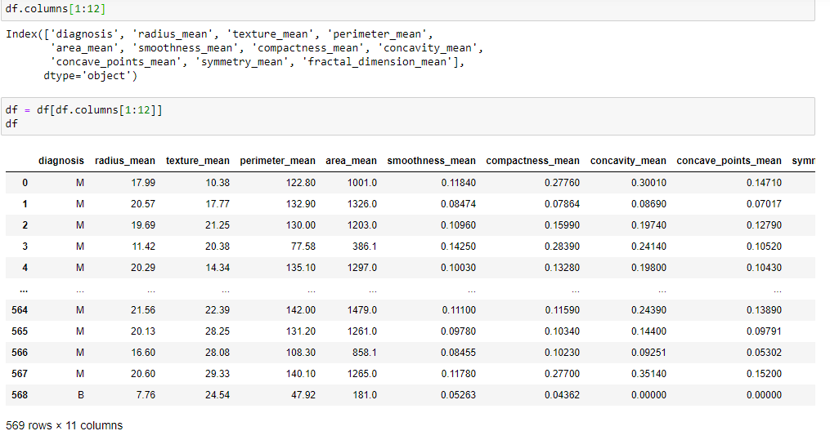
Cleaning our Data
# Lessening the columns
# We notice that “diagnosis” (which will be our y value and help us predict our tumor) looks to be an object
Notes:
From originally 33 columns, we decided to bring the columns down to 11

Slide 9
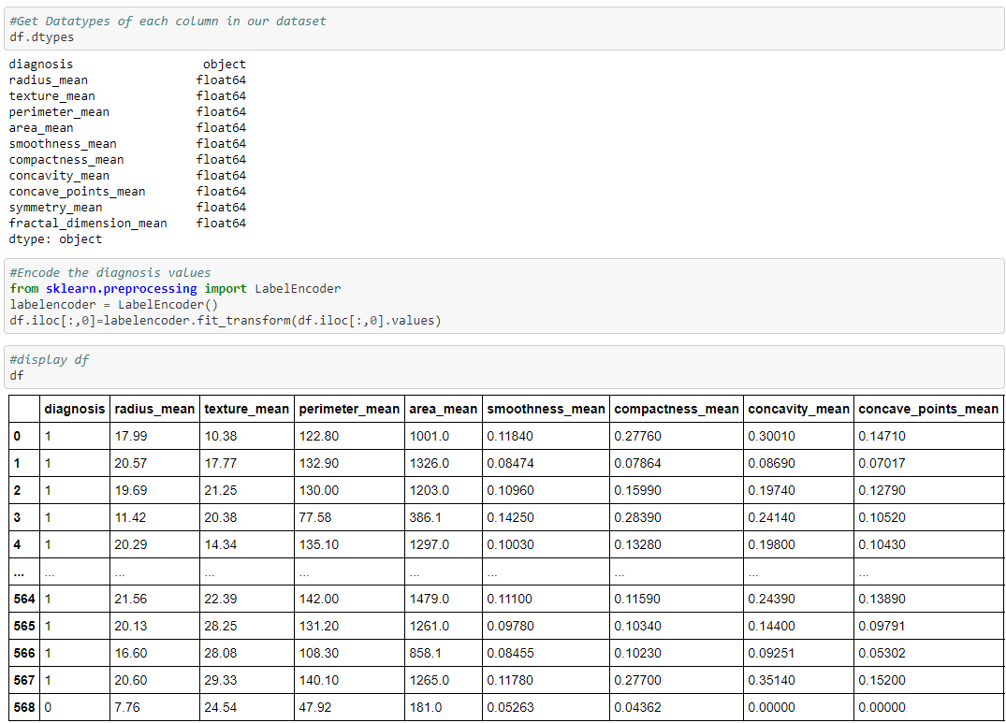
Our Y Value as an Object
# Checking our datatypes to confirm our y value is an object
# After using Label Encoder, our y value gives malignant tumors a value of 1 and benign tumors a value of 0
Notes:
After using the Label Encoder, our y value (which is ‘diagnosis’) gives malignant tumors a value of 1 and benign tumors a value of 0.

Slide 10
Machine Learning Algorithms
Based on this project, we have used four(4) different classification algorithms in Machine Learning.
Decision Tree Algorithm
K-Nearest Neighbors(KNN)
Support Vector Machines(SVM)
Random Forest Classification(RF)

Slide 11
Machine Learning Processes
For all the Machine Learning algorithms used, the following processes were used:
Create the Train Test Split(80% training; 20% testing)
Data Preprocessing
Train the Model
Hyperparameter Tuning
Save the Model
Make the Predictions

Slide 12
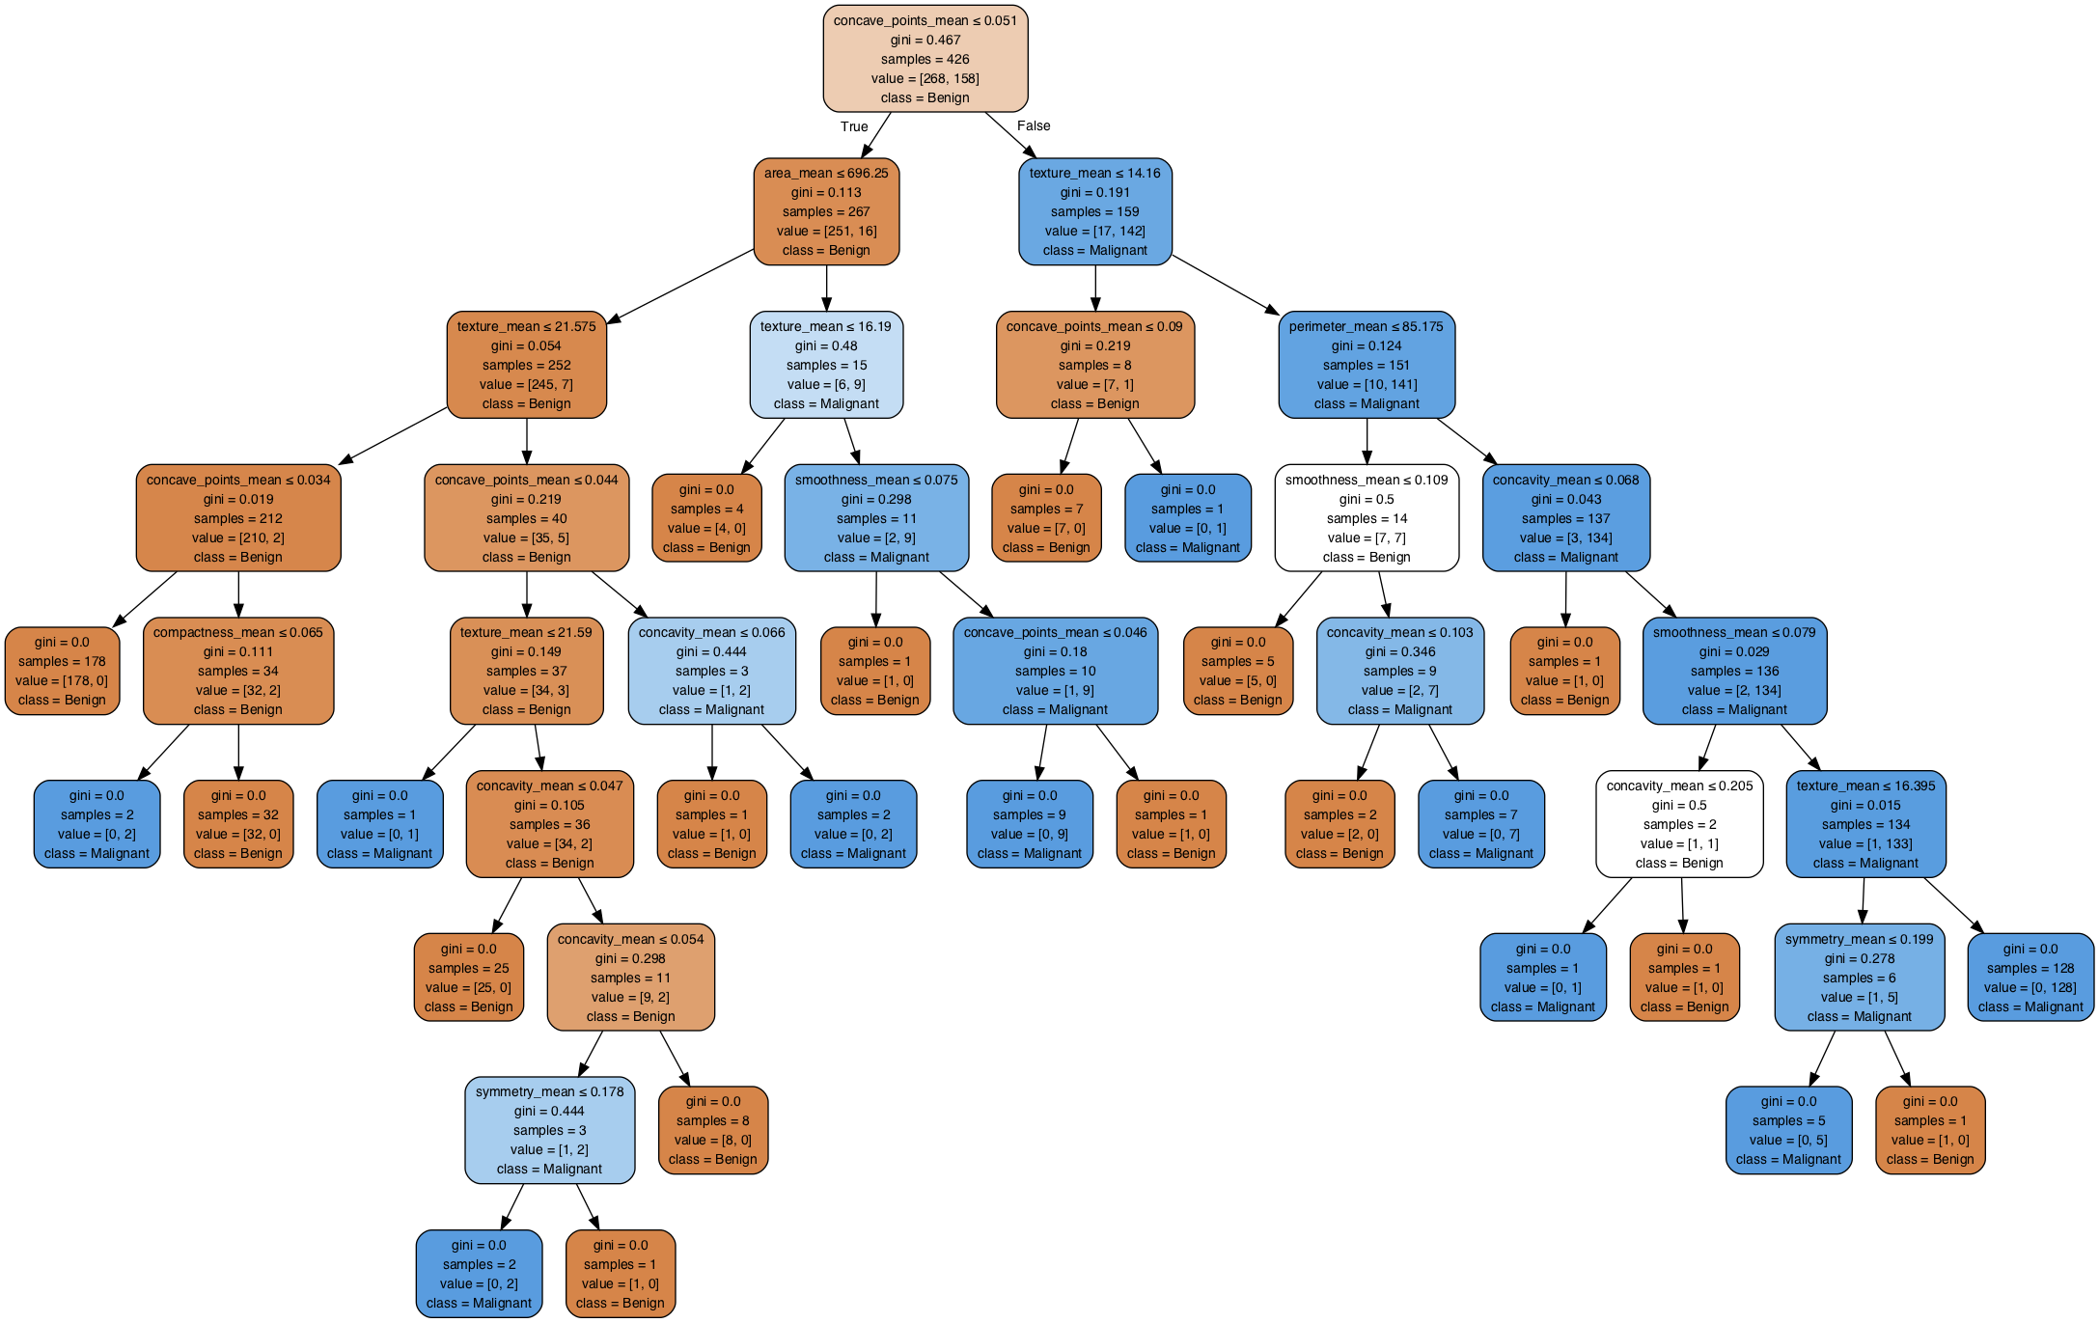
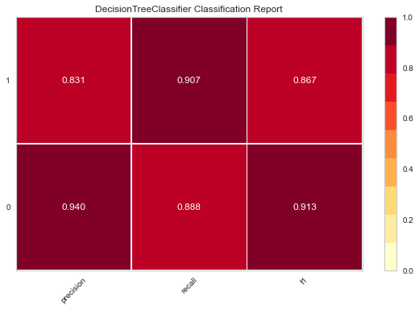
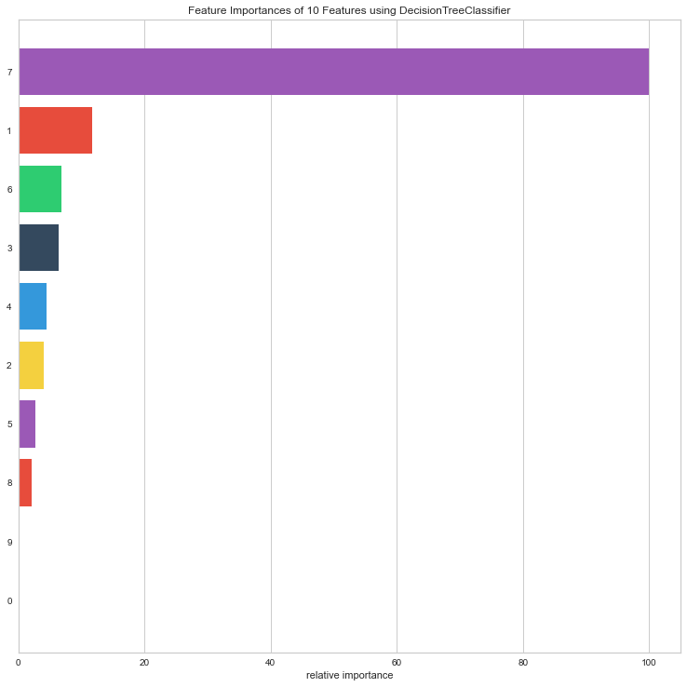
Decision Tree Algorithm
This model encodes a series of true/false questions with a series of if/else statements to make predictions.
Accuracy Score = 91.6%

Slide 13
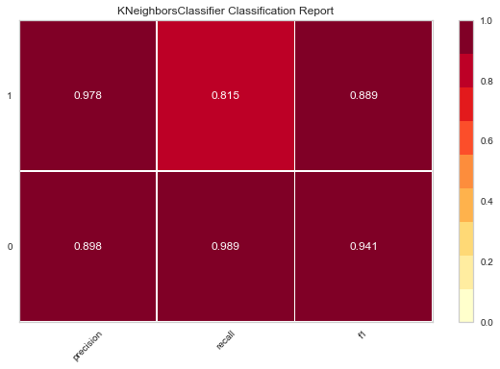
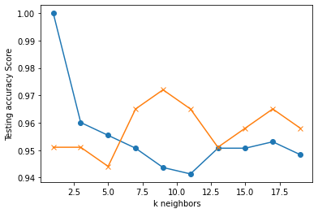
K Nearest Neighbors(KNN)
This model- KNN classifies data points based on the points that are most similar to it.
KNN fit Model
Accuracy score = 95.1%

Slide 14
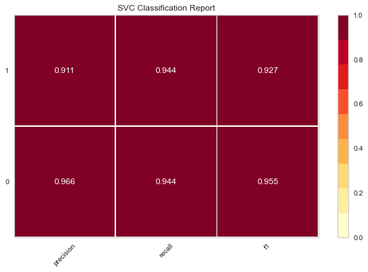
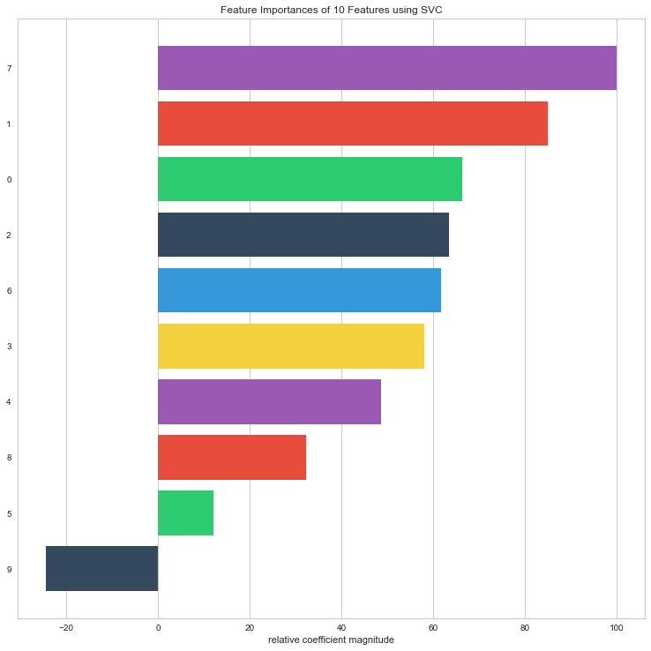
Support Vector Machine(SVM)
The SVM model takes the data as input and it outputs an optimal hyperplane that separates the data points with the largest margin possible.
Accuracy score = 94%.

Slide 15
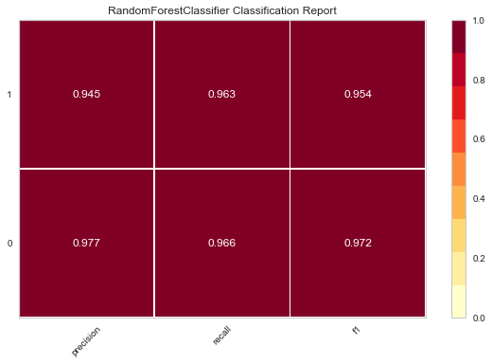
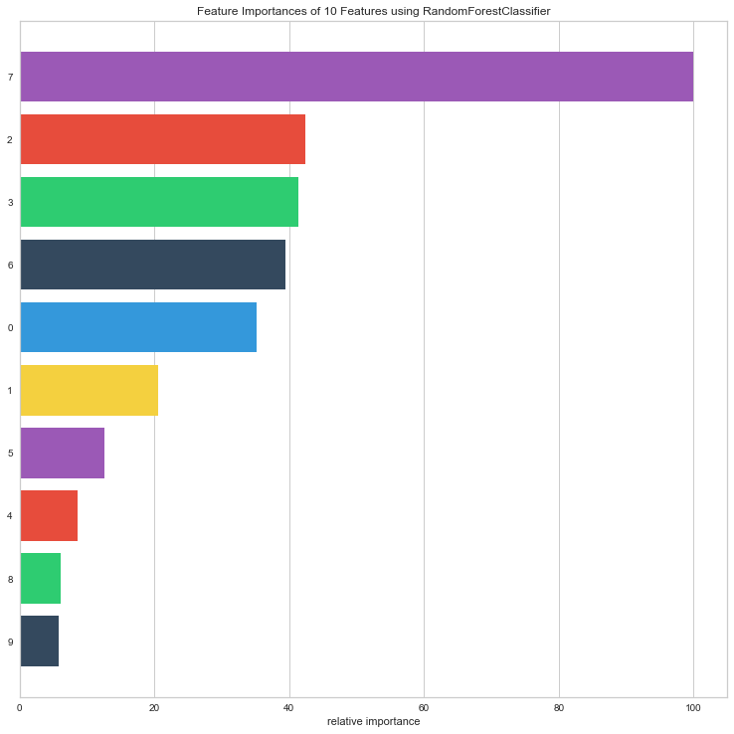
Random Forest Classifier(RF)
The RF model consists of many decision trees which makes a forest and this in turn combine together to form a strong classifier for making predictions.
Accuracy score = 95%.

Slide 16
Models and Summary Score
After applying all the Machine learning models, we got the following summary scores;
Machine Learning Models | Training Score | Testing score | Accuracy Score
Decision Tree Algorithm | 91.6% | 91.0% | 91.6%
K Nearest Neighbors | 95.1% | 95.1% | 95.1%
Support Vector Machines | 94.1% | 93.7% | 94%
Random Forest Classifier | 97.2% | 95.1% | 95%
From the above summary, the Random Forest Classifier gives the best results for our dataset. Therefore, this is the model we are going to be using in building our application going forward.

Slide 17
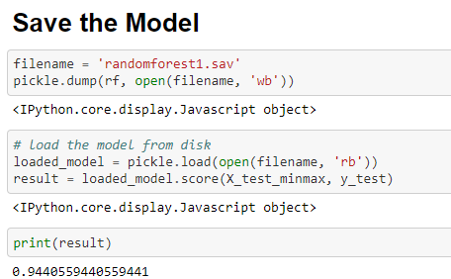
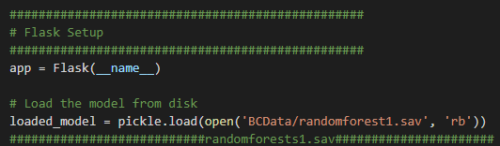
Connection to the Flask API
We used Pickle module to help us connect our RF model to our Flask API:
Pickle is the standard way of serializing objects in Python. One can use the pickle operation to serialize their machine learning algorithm and save the serialized format to a file. Later you can load this file to deserialize your model.

Slide 18
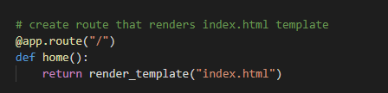
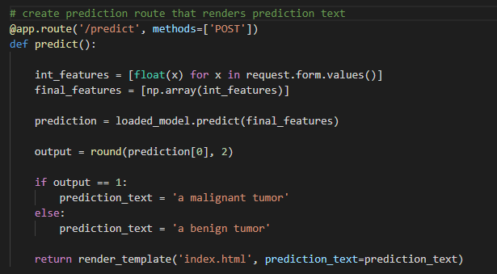
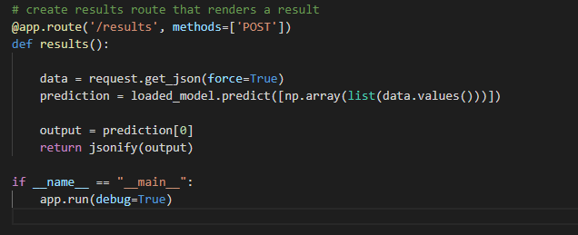
Routes in Our Flask API
Our home route
Our prediction route
Our results route

Slide 19
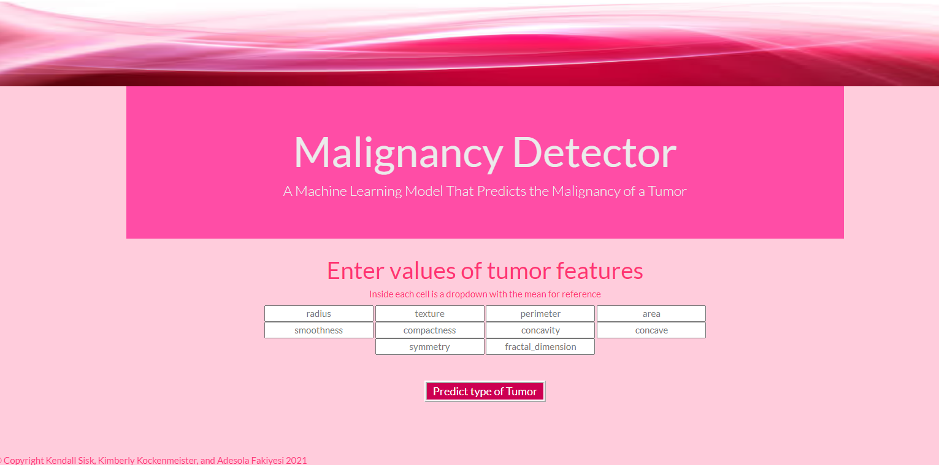
Our Malignancy Detector

Slide 20
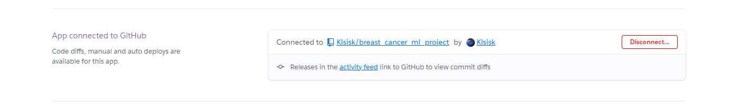
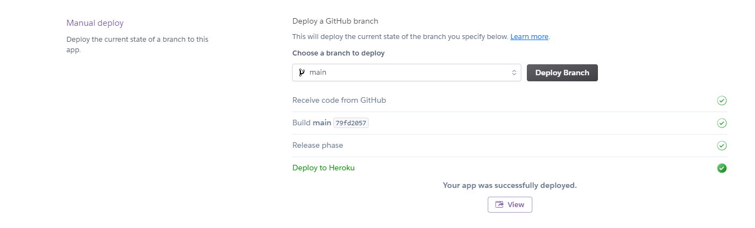
Deployment of the App With Heroku
“Deployment is about moving your application from your local system to Heroku.”
https://breastcancer-ml-detector.herokuapp.com/

Slide 21
Final Reflections
The best accuracy score we got was 95%. However, because we are dealing with lives we would love to have an accuracy as close to 100% as possible so a little more tuning would be necessary.
As with all projects, we wish we had more time to do more with our app.
We would add more resources to our app and try and use more libraries like Leaflet or Plotly to really enhance the app and make it more user-friendly.
We like to improve our app more visually with HTML and D3

Slide 22
Resources
Breast Cancer Wisconsin (Diagnostic) Data Set
Breast Cancer Wisconsin (Diagnostic) Data Set
i. 569 Rows
ii. 32 Columns

Slide 23
Questions?
Thank you for listening!

